Slide 1
Chapter 2
Processes and Threads
2.1 Processes
2.2 Threads
2.3 Interprocess communication
2.4 Classical IPC problems
2.5 Scheduling

Slide 2
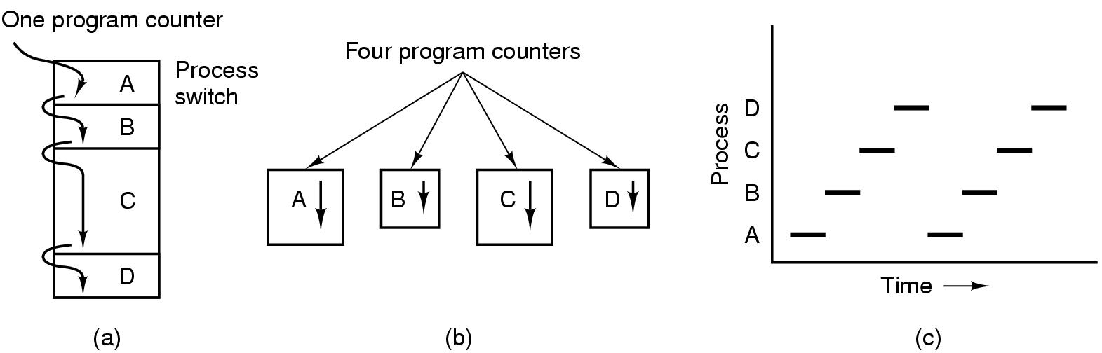
Processes
The Process Model
Multiprogramming of four programs
Conceptual model of 4 independent, sequential processes
Only one program active at any instant

Slide 3
Process Creation
Principal events that cause process creation
1. System initialization
2. Execution of a process creation system
3. User request to create a new process
4. Initiation of a batch job

Slide 4
Process Termination
Conditions which terminate processes
Normal exit (voluntary)
Error exit (voluntary)
Fatal error (involuntary)
Killed by another process (involuntary)

Slide 5
Process Hierarchies
Parent creates a child process, child processes can create its own process
Forms a hierarchy
  UNIX calls this a "process group"
Windows has no concept of process hierarchy
  all processes are created equal

Slide 6
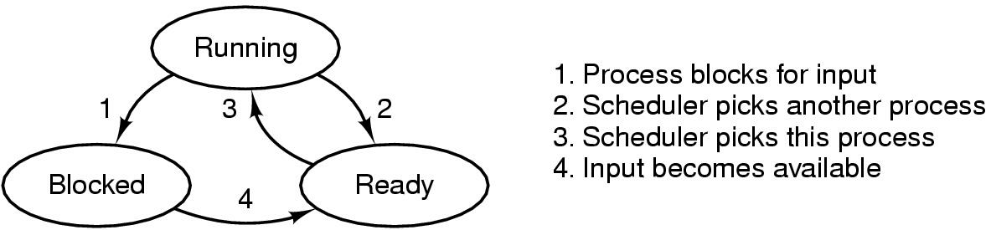
Process States (1)
Possible process states
  running
  blocked
  ready
Transitions between states shown

Slide 7
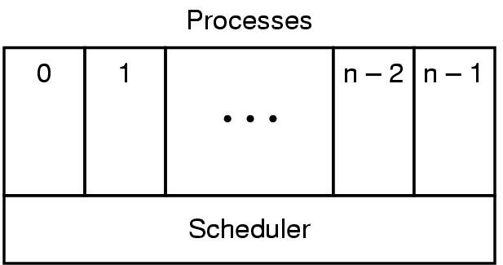
Process States (2)
Lowest layer of process-structured OS
  handles interrupts, scheduling
Above that layer are sequential processes

Slide 8
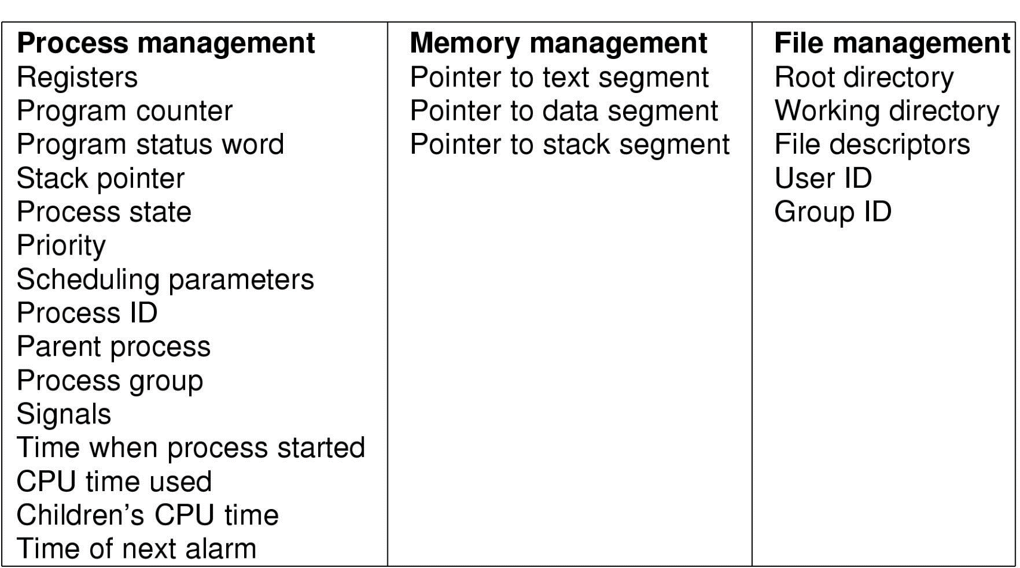
Implementation of Processes (1)
Fields of a process table entry

Slide 9
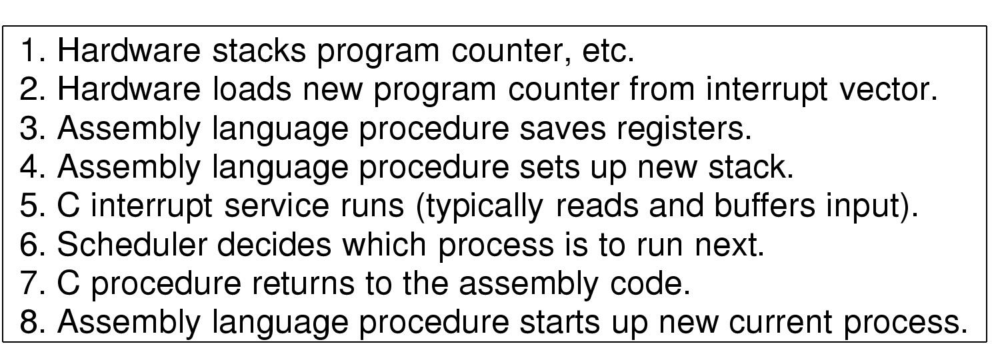
Implementation of Processes (2)
Skeleton of what lowest level of OS does when an interrupt occurs

Slide 10
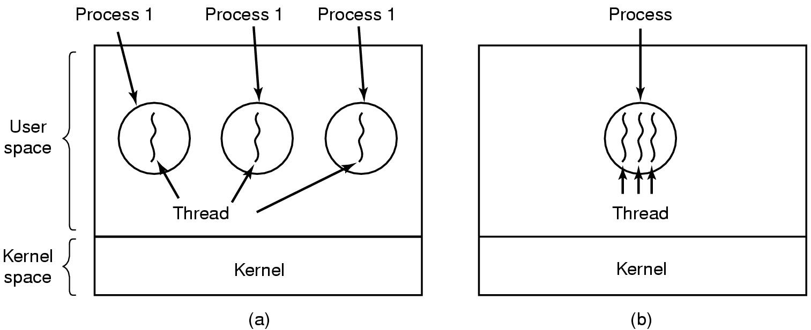
Threads
The Thread Model (1)
(a) Three processes each with one thread
(b) One process with three threads

Slide 11
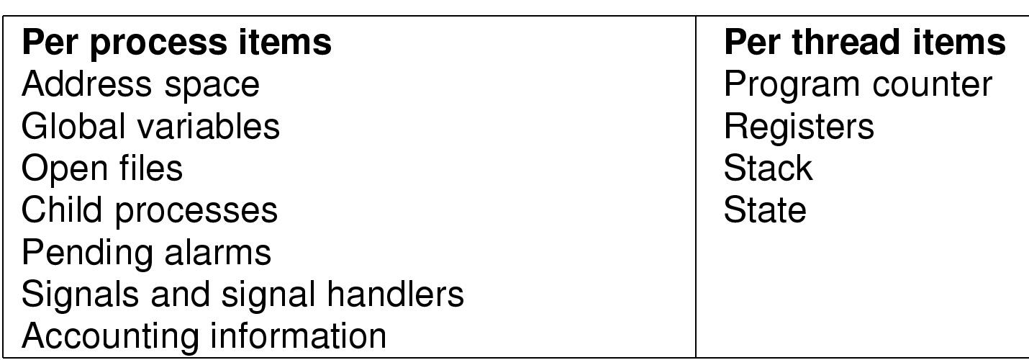
The Thread Model (2)
Items shared by all threads in a process
Items private to each thread

Slide 12
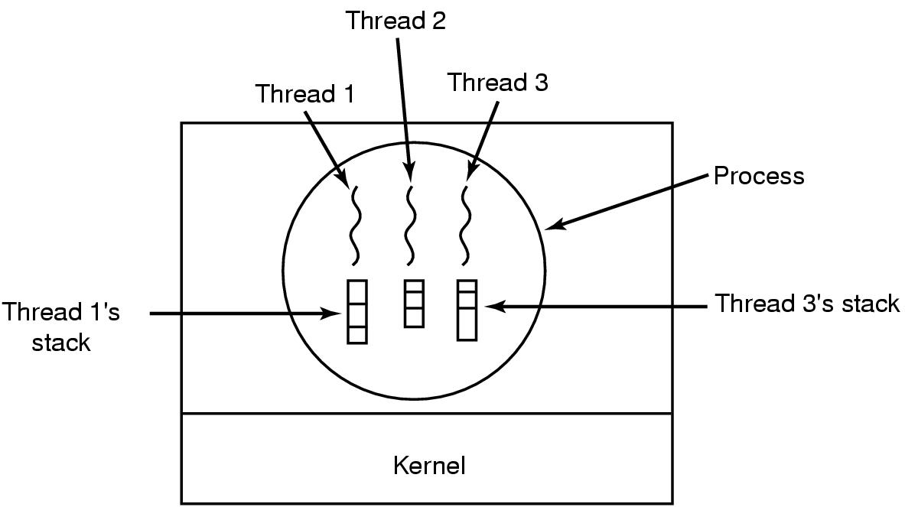
The Thread Model (3)
Each thread has its own stack

Slide 13
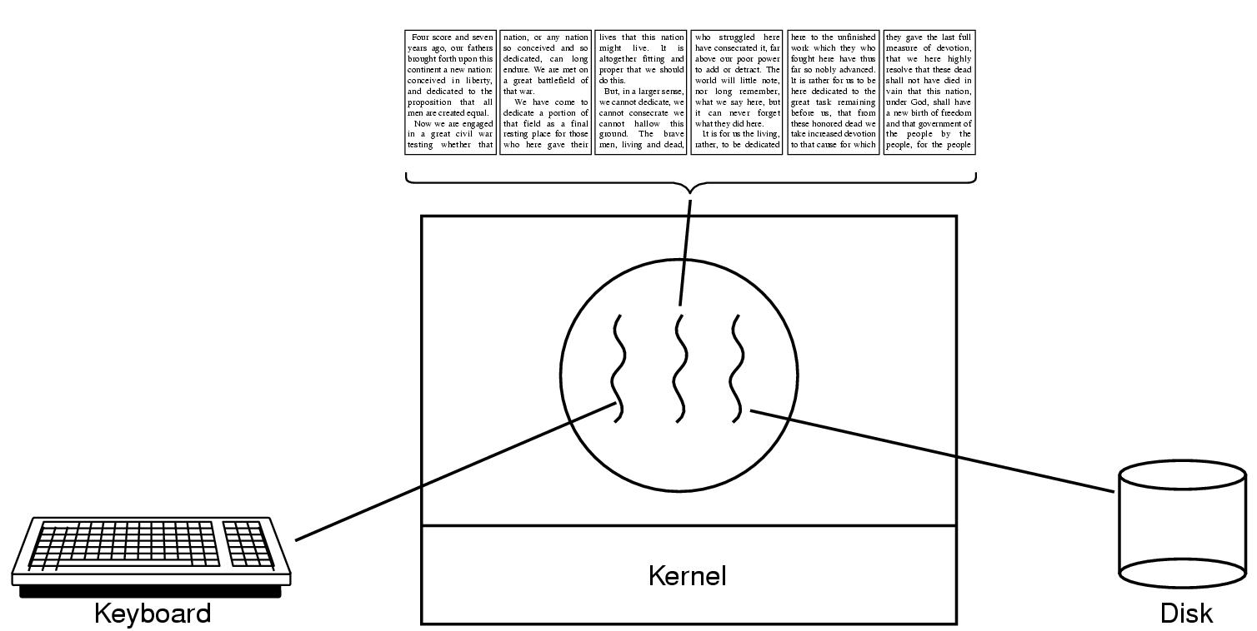
Thread Usage (1)
A word processor with three threads

Slide 14
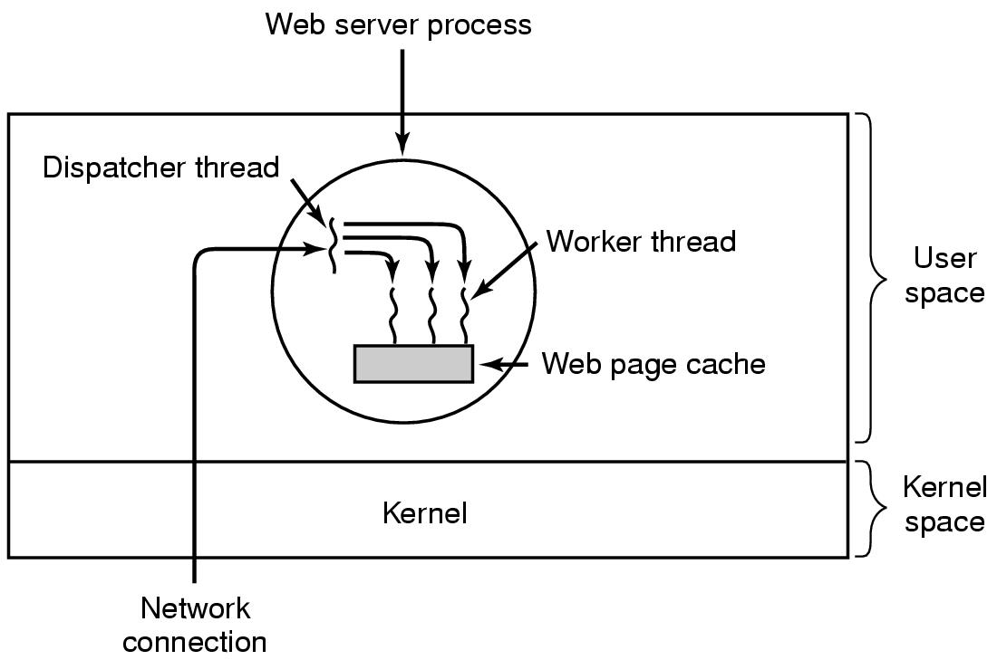
Thread Usage (2)
A multithreaded Web server

Slide 15
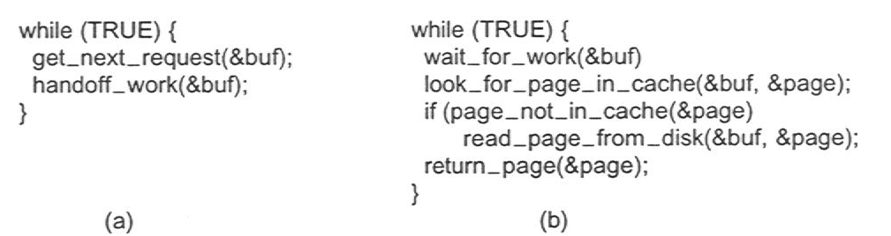
Thread Usage (3)
Rough outline of code for previous slide
  (a) Dispatcher thread
  (b) Worker thread

Slide 16
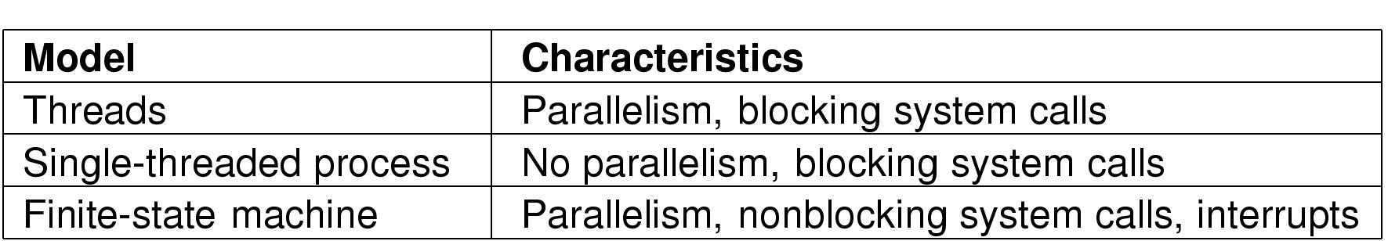
Thread Usage (4)
Three ways to construct a server

Slide 17
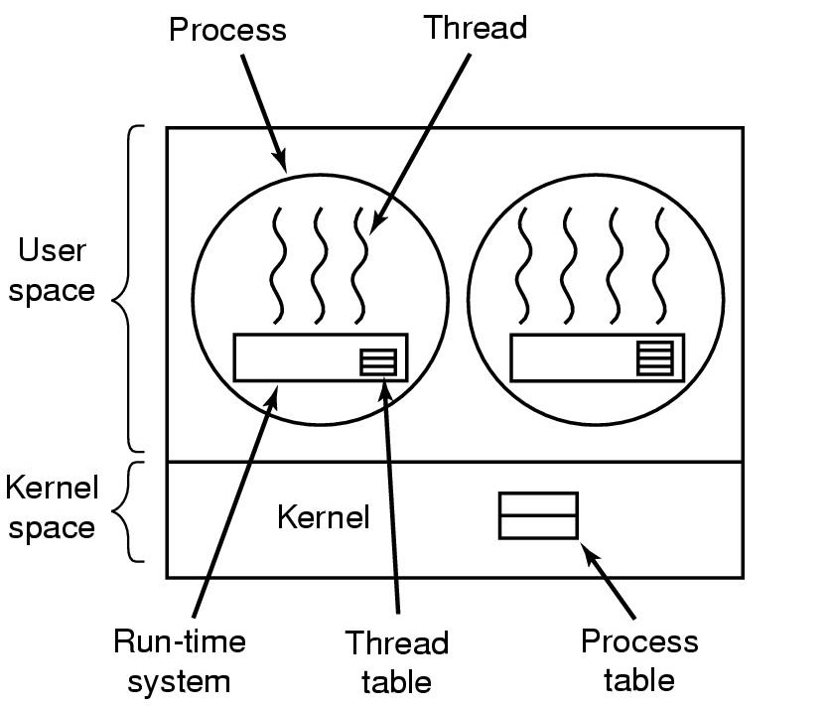
Implementing Threads in User Space
A user-level threads package

Slide 18
User Level Threads: Advantage
Can be implemented on an non-thread OS
Thread switching can be implemented to be at least an order of magnitude faster than trapping to kernel.
  Run time system procedures are used
Similarly scheduling can be very fast
Scale better. Because kernel threads would require some table and stack space in kernel and if no. of threads increases… PROBLEMS

Slide 19
User Level Threads:Problems(1)
Blocking system calls implementation issue
  If a thread’s call blocks the whole process will be blocked!!!
During “page fault” the entire process is blocked since kernel only knows the process
  Even though other threads might be runnable

Slide 20
User Level Threads:Problems(2)
Most Devastating Arguments (Against):
  Threads are needed for applications blocking often by system calls. Once a trap has occurred to kernel for the system call it is hardly more work for the kernel to switch threads

Slide 21
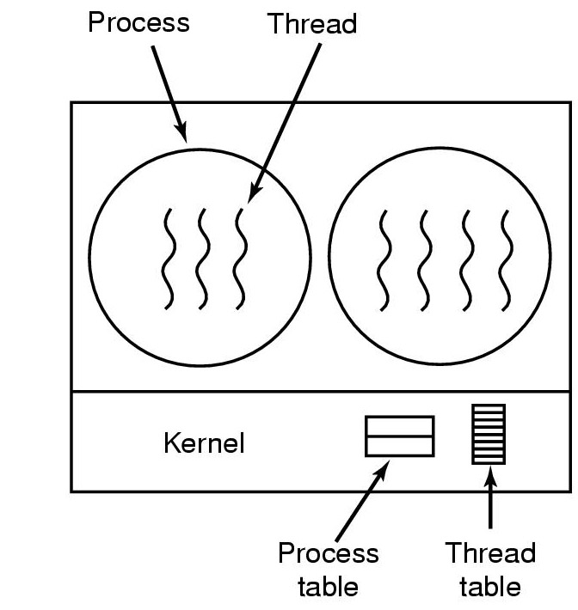
Implementing Threads in the Kernel
A threads package managed by the kernel

Slide 22
Kernel Threads
Advantages
  No need for non-blocking system calls
  In case of a page fault since the kernel knows about the threads it can do thread (or if needed process) switch
Disadvantages
  Cost of system call is substantial as oppossed to run time system procedure

Slide 23
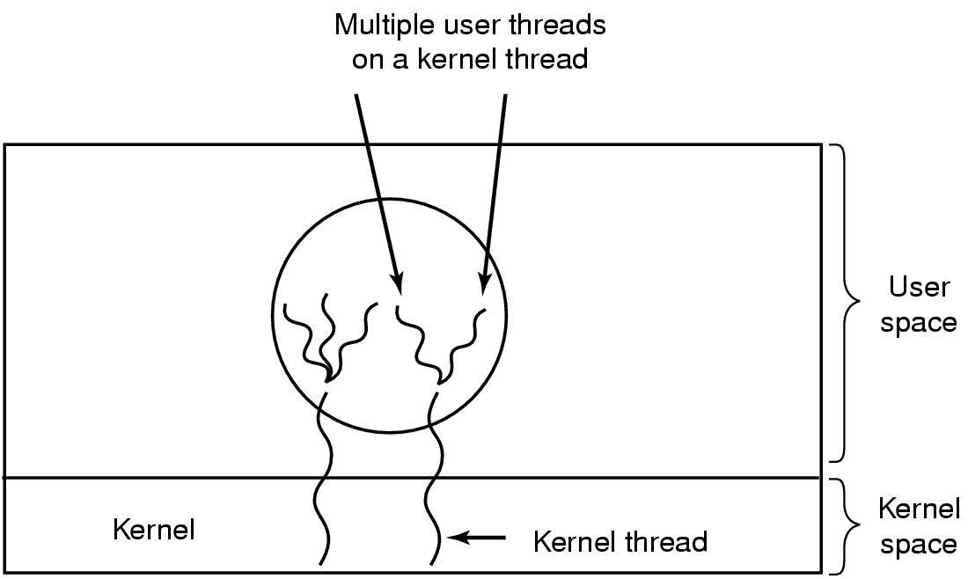
Hybrid Implementations
Multiplexing user-level threads onto kernel- level threads

Slide 24
Hybrid Implementations
Combining the advantages of the 2 methods
Now the programmer can decide how many kernel threads to use and how many user-level threads to multiplex on each one.

Slide 25
Hybrid implementation examples:
Scheduler Activations
Goal
  – mimic functionality of kernel threads
  gain performance of user space threads
Avoids unnecessary user/kernel transitions
  If a thread blocks for another thread, why involve kernel?

Slide 26
Scheduler Activations(2)
Basic Idea:
  When a thread is blocked, kernel notifies the process’ run-time system passing parameters:
    Number of the thread
    The description of the event that occurred
  Notification:
    Kernel activates the run-time system at a known starting address.
  Run-time systems then can do scheduling
  As soon as the blocked thread is ready, kernel performs another upcall to inform run-time system.
  It is upto run-time system to schedule.
Upcall

Slide 27
Scheduler Activations(3)
Problems:
  Fundamental reliance on upcalls which doesn’t follow a fundamental principle of layered systems
Layer n (lower layer for e.g. kernel) offers certain services that layer n + 1 (upper layer for e.g. user space) can call on, but layer n may not call procedures in layer n + 1

Slide 28
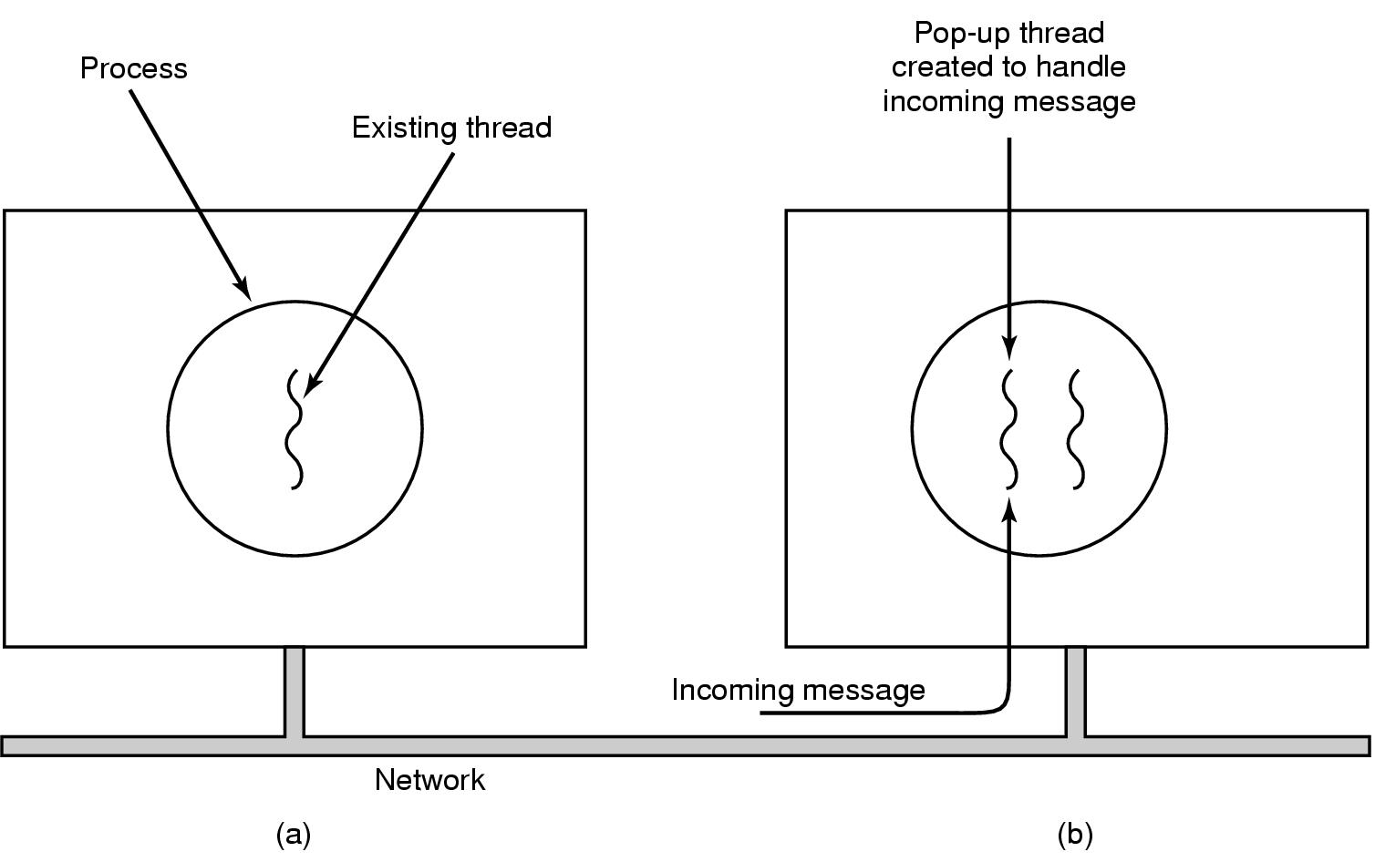
Pop-Up Threads
Creation of a new thread when message arrives
  (a) before message arrives
  (b) after message arrives

Slide 29
Pop-Up Threads: Advantages
Pop-up threads do not have any history- registers, stack etc to restore
Each one starts out fresh and is identical to all others
So Creation of thread is very quick
The new thread is given the incoming message to process
Result: Latency between the message arrival and the start of the process is very short

Slide 30
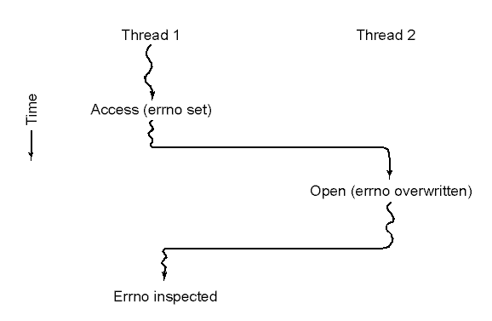
Making Single-Threaded Code Multithreaded (1)
Conflicts between threads over the use of a global variable

Slide 31
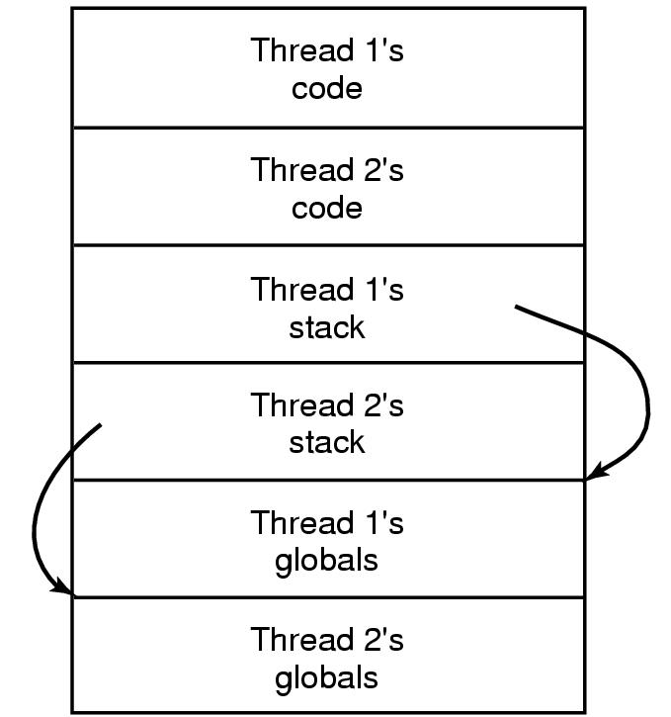
Making Single-Threaded Code Multithreaded (2)
Threads can have private global variables

Slide 32
Interprocess Communication
Processes often need to communicate with other processes
Example: shell pipeline
Now we’ll look at some issues related to IPC.

Slide 33
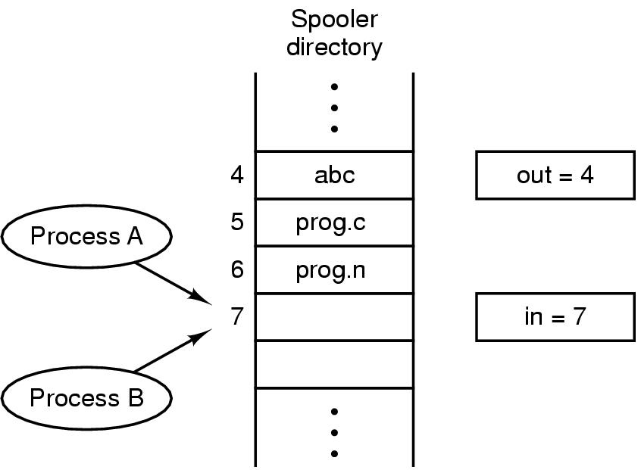
Race Conditions
Two processes want to access shared memory at same time

Slide 34
How to avoid race condition?
Mutual Exclusion:
  No 2 processes use a shared data at the same time
  If one process is using a shared data , the other process will be excluded from doing the same thing
Critical Region:
  That part of the program that do critical things such as accessing shared memeory
  Can lead to race condition

Slide 35
Solution
Four conditions for a good solution
No two processes simultaneously in critical region
No assumptions made about speeds or numbers of CPUs
No process running outside its critical region may block another process
No process must wait forever to enter its critical region

Slide 36
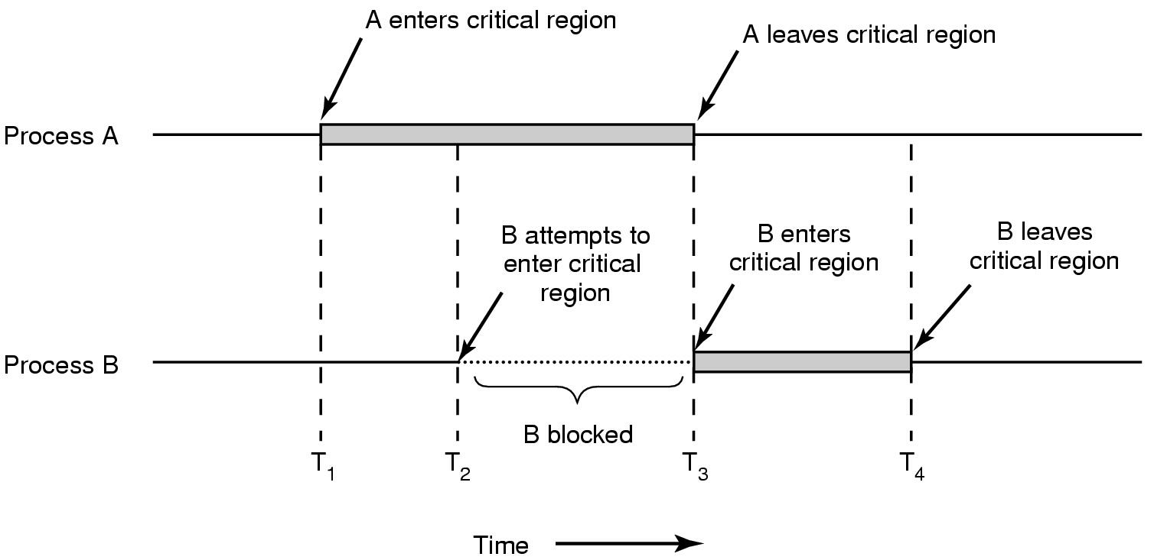
Solution
Mutual exclusion using critical regions

Slide 37
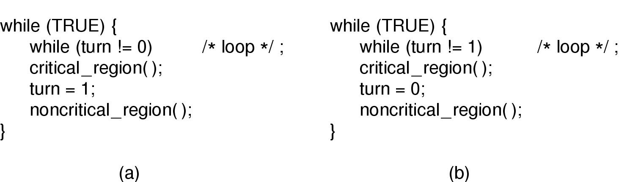
Mutual Exclusion with Busy Waiting (1)
Proposed solution to critical region problem
  (a) Process 0. (b) Process 1.

Slide 38
Problem
Busy waiting: Continuously testing a variable until some value appear
  Wastes CPU time
Violates condition 3
  When one process is much slower than the other

Slide 39
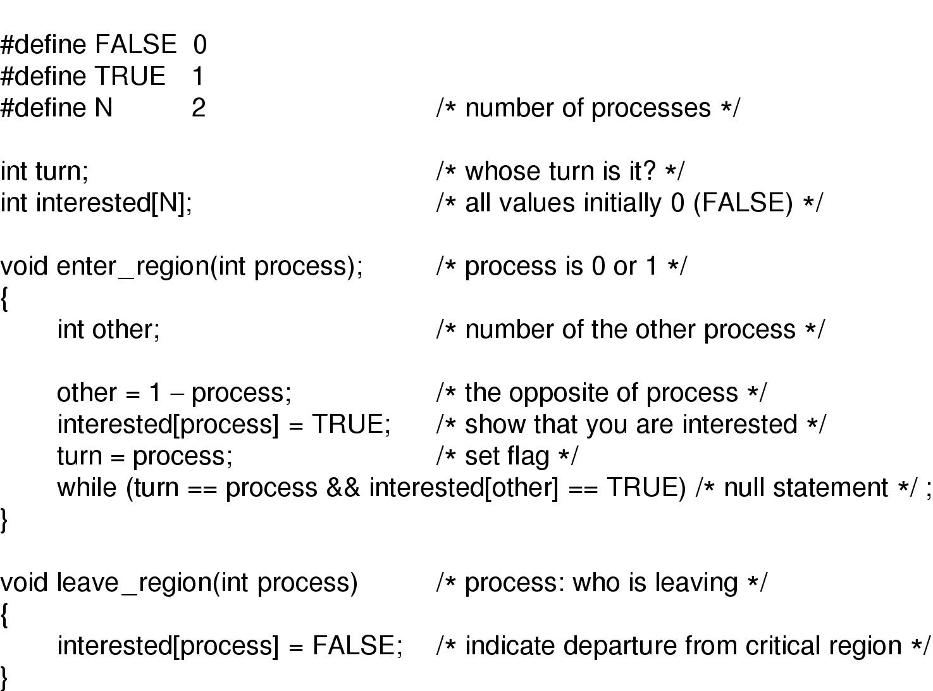
Mutual Exclusion with Busy Waiting (2)
Peterson's solution for achieving mutual exclusion

Slide 40
Mutual Exclusion with Busy Waiting
Peterson’s Solution: Analysis(1)
Let Process 1 is not interested and Process 0 calls enter_region with 0
So, turn = 0 and interested[0] = true and Process 0 is in CR
Now if Process 1 calls enter_region, it will hang there until interested[0] is false. Which only happens when Process 0 calls leave_region i.e. leaves the CR

Slide 41
Mutual Exclusion with Busy Waiting
Peterson’s Solution: Analysis(2)
Let both processes call enter_region simultaneously
Say turn = 1. (i.e. Process 1 stores last)
Process 0 enters critical region: while (turn = = 0 && …) returns false since turn = 1.
Process 1 loops until process 0 ex: while (turn = = 1 && interested[0] = = true) returns true.
Done!!

Slide 42
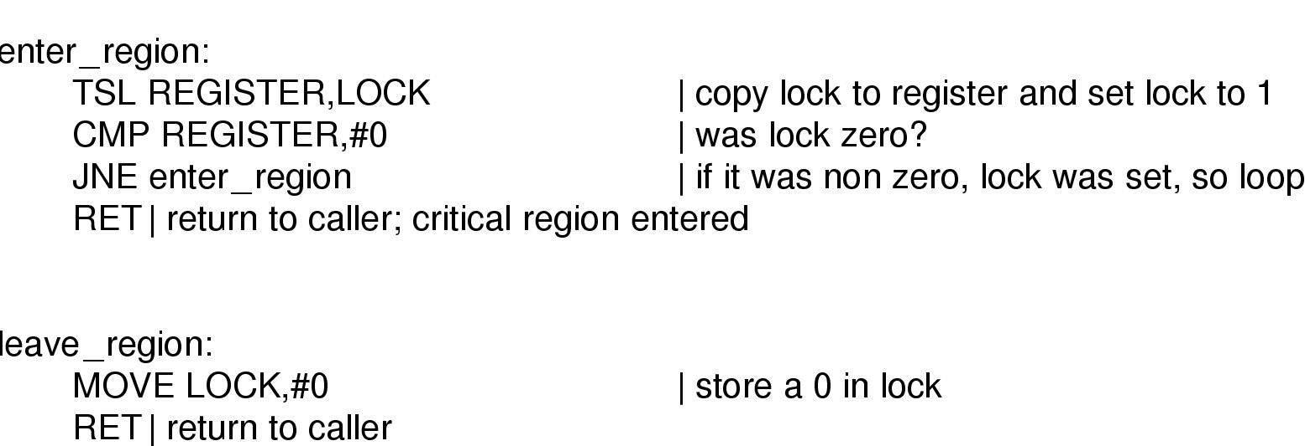
Mutual Exclusion with Busy Waiting: TSL
Requires hardware support
TSL instruction: test and set lock
  Reads content of lock into a Register
  Stores a nonzero value at lock.
CPU executing TSL locks the memory prohibiting other CPUs
Indivisible/Atomic

Slide 43
Busy Waiting: Problems
Waste CPU time since it sits on a tight loop
May have unexpected effects:
  Priority Inversion Problem
    a high priority waits for a low priority to leave the critical section
    the low priority can never execute since the high priority is not blocked.
Example:
Process H and L with scheduling rule that L is never scheduled while H is scheduled. Let L in CR and H is ready and wants to enter CR. Since H is ready it is given the CPU and it starts busy waiting. L will never get to run
Solution: Sleep and Wake-up

Slide 44
Producer Consumer Problem
Also called bounded-buffer problem
Two (m+n) processes share a common buffer
One (m) of them is (are) producer(s): put(s) information in the buffer
One (n) of them is (are) consumer(s): take(s) information out of the buffer
Trouble and solution
  Producer wants to put but buffer full- Go to sleep and wake up when consumer takes one or more
  Consumer wants to take but buffer empty- go to sleep and wake up when producer puts one or more

Slide 45
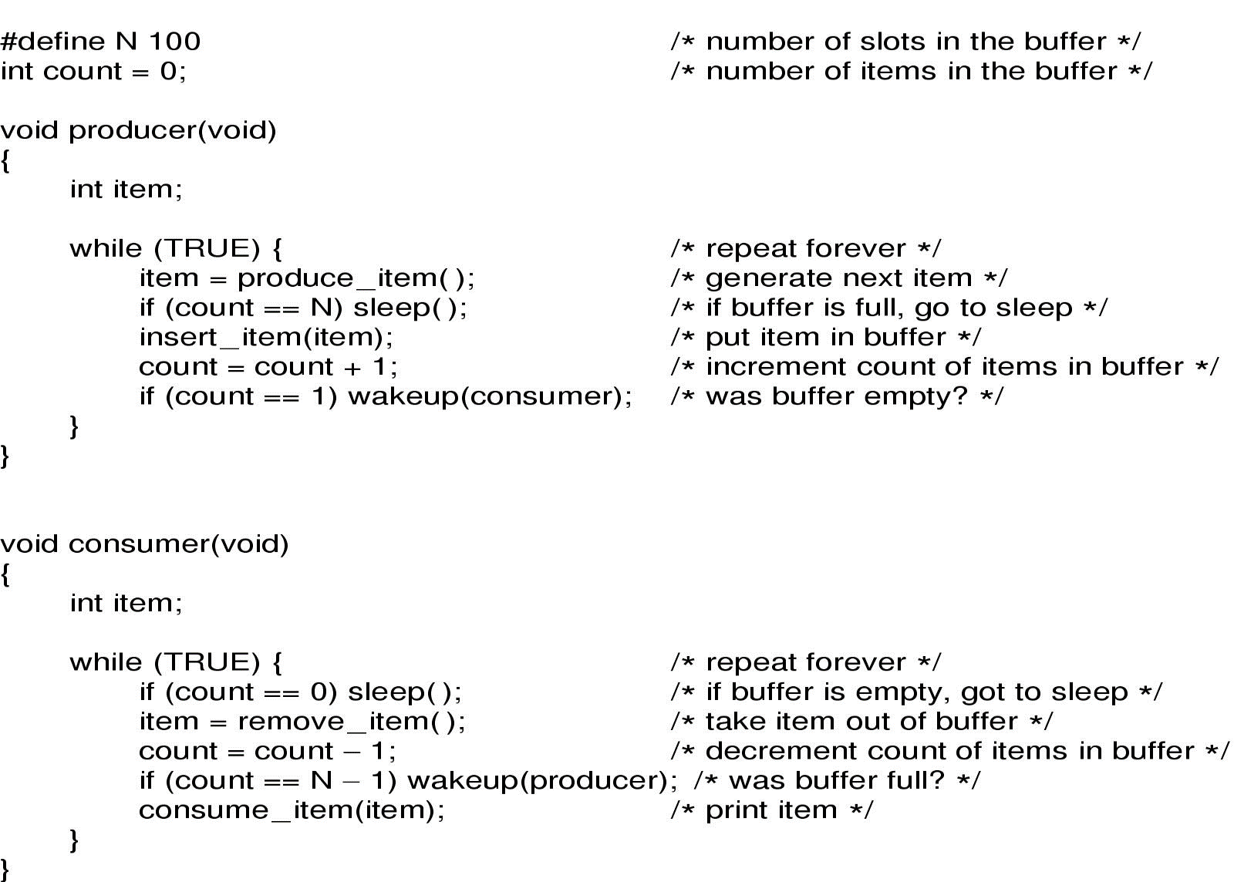
Sleep and Wakeup
Problems are discussed in the next slide
Producer-consumer problem with fatal race condition

Slide 46
Sleep and Wakeup: Race condition
Unconstrained access to count
  CPU is given to P just after C has read count to be 0 but not yet gone to sleep.
  Result is lost wake-up signal
  Both will sleep forever

Slide 47
Lost Wakeup Signal
Process A wants to wakeup B, who is not in sleep yet.
Quick fix: wakeup-bit
  When A calls wakeup(B) and B is not in sleep, set the bit
  When B wants to sleep and the bit is set, B will not sleep
Problem- When more than 2 processes? We need more bits. So the problem remains in principle.
Dept. of CSE, BUET

Slide 48
Semaphores(1)
A new variable type
Value = 0 => No wakeups are saved
Value > 0 => One or more wakeups are saved
Two operations: Down and UP
Operation “down”: if value > 0 value-- (uses up one stored wakeup) and then continue. if value = 0, process is put to sleep without completing the down for the moment
  Checking the value, changing it, and possibly going to sleep, is all done as an atomic action. So once a semaphore operation has started, no other process can access it until the operation has completed or blocked.

Slide 49
Semaphores(2)
Operation “up”:increments the value of the semaphore addressed. If one or more process were sleeping on that semaphore, one of them is chosen by the system (e.g. at random) and is allowed to complete its down
  The operation of incrementing the semaphore and waking up one process is also indivisible
No process ever blocks doing an up.

Slide 50
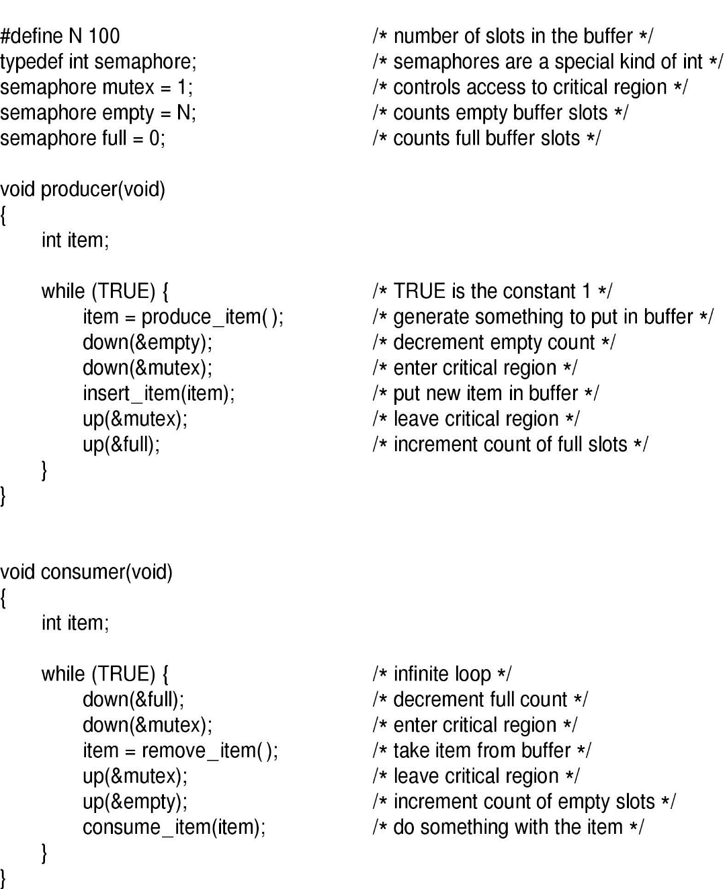
Semaphores(3)
The producer-consumer problem using semaphores

Slide 51
Semaphores in Producer Consumer Problem: Analysis
3 semaphores are used
  full (initially 0) for counting occupied slots
  Empty (initially N) for counting empty slots
  mutex (initially 1) to make sure that P and C donot access the buffer at the same time.
Binary Semaphores: That are initialized to one and used by 2 or more processes to ensure that only one of them enter CR
If each process does a down just before entering CR and an up just after leaving then mutual exclusion is guarrented
Here 2 uses of semaphores
  Mutual exclusion (mutex)
  Synchronization (full and empty): to guarantee that certain event sequences do or do not occur

Slide 52
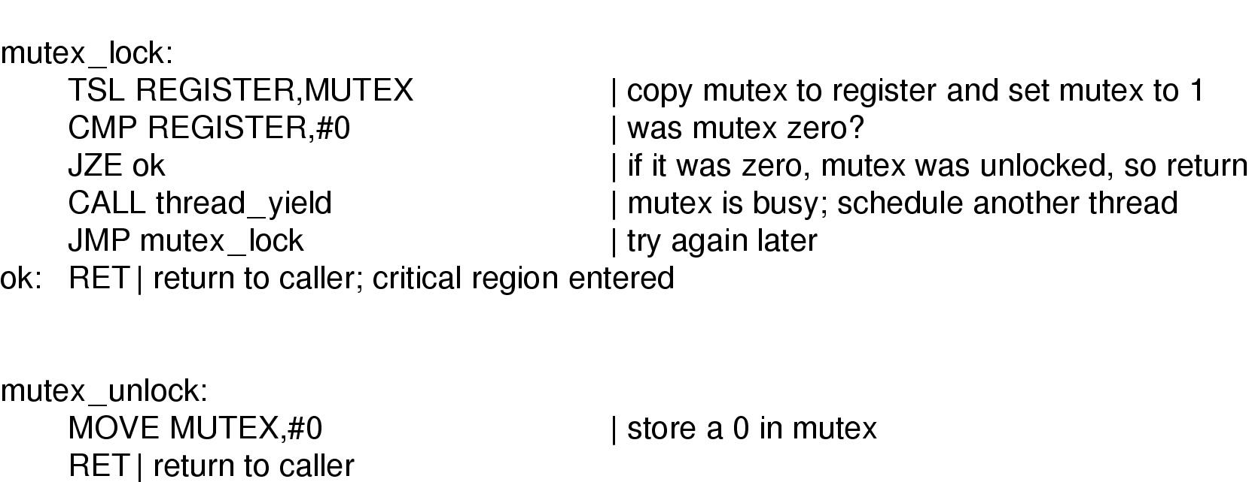
Mutexes
A mutex is a variable that can be in 1 of 2 states: locked and unlocked.
Two procedures: mutex_lock and mutex_unlock
Similar like enter_region with a crucial difference
Implementation of mutex_lock and mutex_unlock

Slide 53
Semaphores: “Be Careful”
Suppose the following is done in P’s code
If buffer full P would block due to down(&empty) with mutex = 0.
So now if C tries to access the buffer, it would block too due to its down(&mutex).
Both processes would stay blocked forever: DEADLOCK
…
down(&empty)
down(&mutex)
…
…
down(&mutex)
down(&empty)
…
Just the order is reversed

Slide 54
Revisiting semaphores!
Semaphores are very “low-level” primitives
  Users could easily make small errors
  Very difficult to debug
Also, we seem to be using them in two ways
  For mutual exclusion, the “real” abstraction is a critical section
  But for Synchronization threads “communicate” using semaphores
Simplification: Provide concurrency support in compiler
  Monitors
03/21/17
Dept. of CSE, BUET

Slide 55
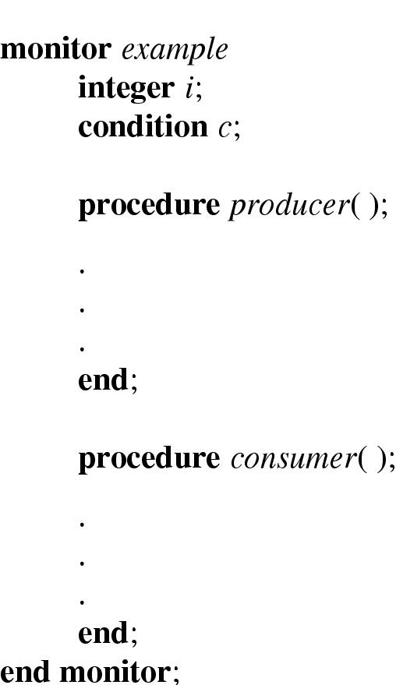
Monitors (1)
A higher level synchronization primitive
A collection of procedures, variables and data structures grouped in a special kind of module or package.
Example of a monitor

Slide 56
Monitors(2)
Only one process can be active in a monitor at any instant
Monitors are programming language construct, so the compiler knows they are special and can handle calls to monitor procedures differently from other calls.
Because the compiler, not the programmer, is arranging the mutual exclusion it is safer
We also need a way to block and wakeup: Wait and Signal (done on a condition variables)

Slide 57
Monitors(3)
wait is called on some condition variables:
  Calling process is blocked and another process that had been previously prohibited from entering the monitor is allowed to enter now.
signal is called on some condition variable:
  A process waiting on that CV is given the chance to get up.
  Who should run? Caller or awakened one?
  Alternative#1: Let newly awakened process to run suspending the caller.
  Alternative#2: Process doing a signal must exit the monitor immediately i.e. signal statement may appear only as the final statement in a monitor procedure.
  Alternative#3: Let the caller run and when it exits the monitor then the waiting process is allowed to start.
  Note: If more than one processes are waiting on full, one of them is scheduled.

Slide 58
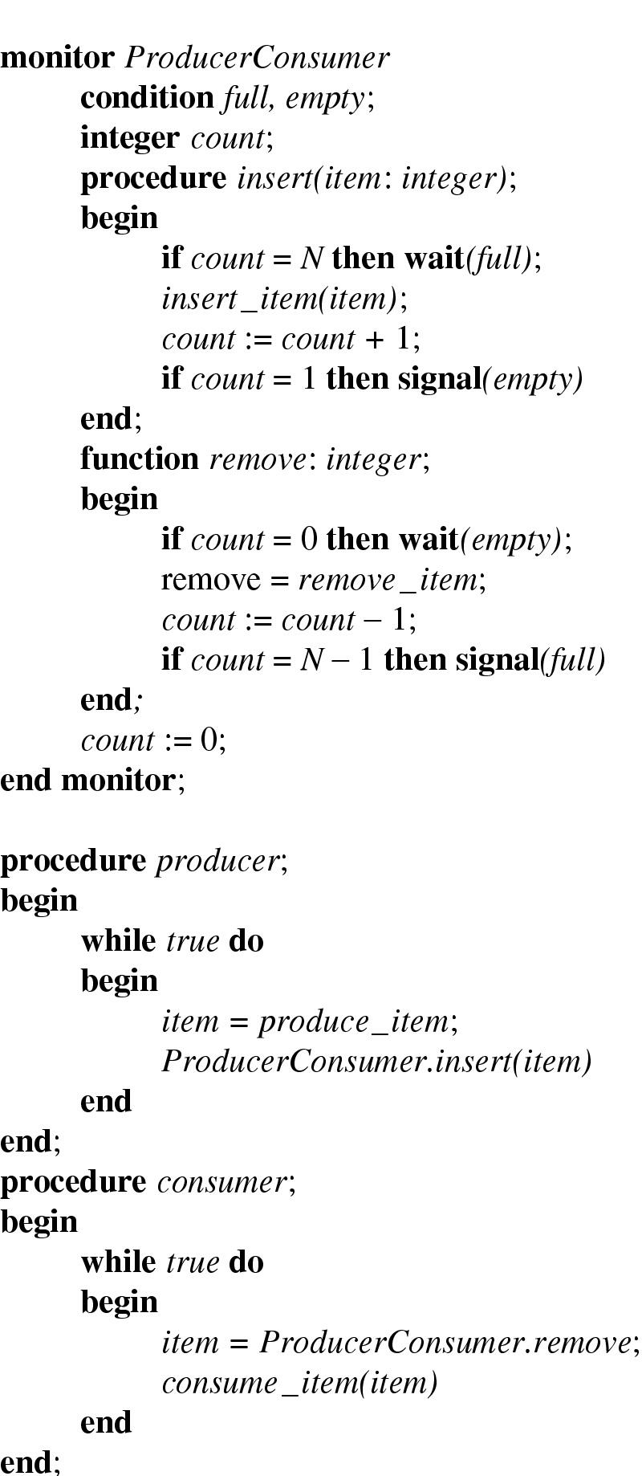
Monitors (4)
Outline of producer-consumer problem with monitors
  only one monitor procedure active at one time
  buffer has N slots

Slide 59
Problems with monitors and semaphores
  Semaphores are too low level
  Monitors are not usable except in a few programming languages
  Designed to work in an environment having access to a common memory
  Doesn’t allow information exchange among machines
  None of them would work in a distributed systems (why?) consisted of multiple CPUs, each with its own private memory.

Slide 60
Message Passing
solution to the problem of semaphores and monitors w.r.t distributed systems
A method of IPC that uses two primitives
  send and receive: system calls.
  send(destination, &message)
  receive(source, &message)
  If no message is available:
    The receiver can block until one arrives
    Return immediately with an error code

Slide 61
Message Passing
Challenges:
  Messages can be lost by the network.
  Acknowledgement and retransmission issue.
  Process naming.
  Authentication.
  Performance issue.

Slide 62
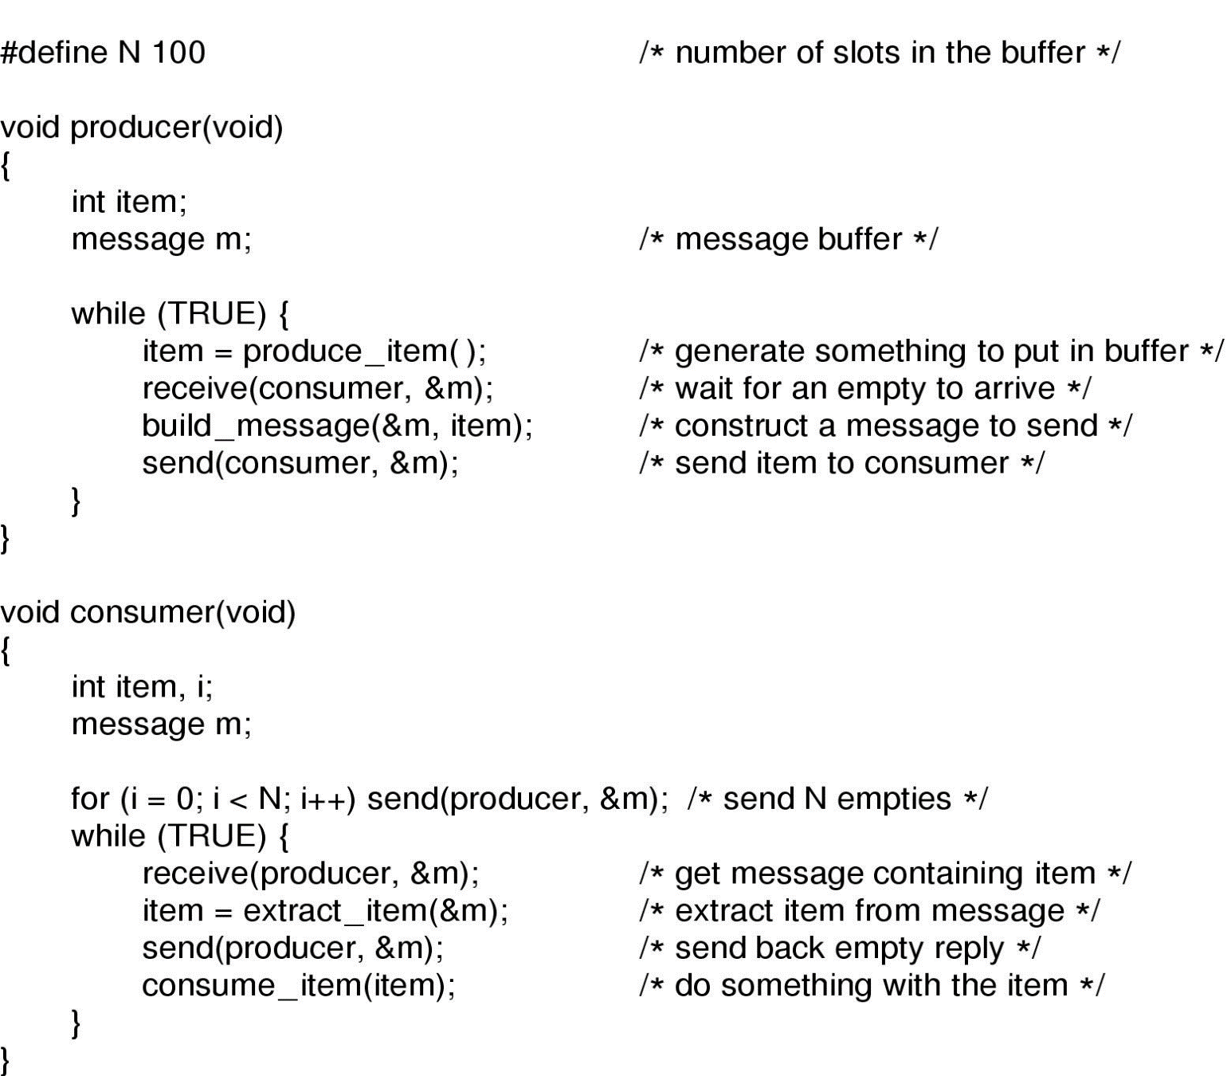
Producer Consumer with Message Passing
Assumptions:
All messages are of same size
Messages sent but not yet received are automatically buffered
The producer-consumer problem with N messages

Slide 63
Many Variants of Message Passing
How messages are addressed?
  Assign each process a unique address and have messages be addressed to processes
  Invent and use a new data structure, mailbox-a place to buffer a certain number of messages. So here mailboxes have addresses
Buffering?
  Mailbox s a kind of buffering
  Other extreme is to eliminate buffering- Rendezvous-if send is done first then sender is blocked until receive happens and vice versa (Easier to implement than buffering)

Slide 64
Barriers
A synchronizing mechanism intended for groups of processes
Some applications are divided into phases and have the rule that no process may proceed into the next phase until all processes are ready to proceed to the next phase.
This can be done by placing a barrier at the end of each phase.
When a process reaches the barrier, it is blocked until all processes have reached the barrier.

Slide 65
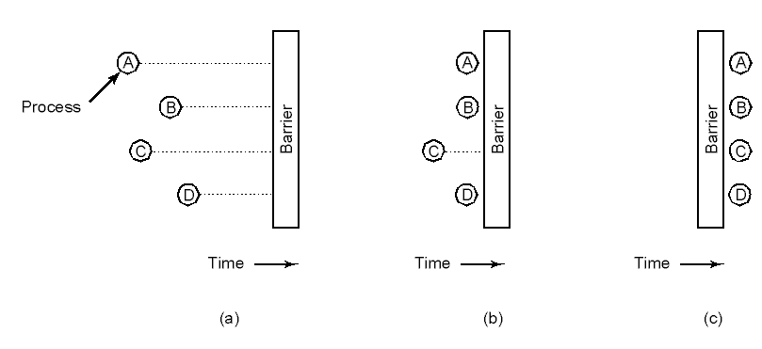
Barriers
Executes a barrier primitive
Use of a barrier
  processes approaching a barrier
  all processes but one blocked at barrier
  last process arrives, all are let through

Slide 66
Semaphore Usage
A lock permits only 1 process/thread to be in Critical Section.
What if we want maximum m process/thread to be in the critical section simultaneously ?
Semaphore from railway analogy
  Here is a semaphore initialized to 2 for resource control:
Non critical
Critical : 2 Cars permitted at a time
Non Critical
Value=2
Value=1
Value=0
Value=1
Value=0
Value=2

Slide 67

Dining Philosophers
Philosophers eat/think
Eating needs 2 forks
Pick one fork at a time
How to program the scenario properly?

Slide 68
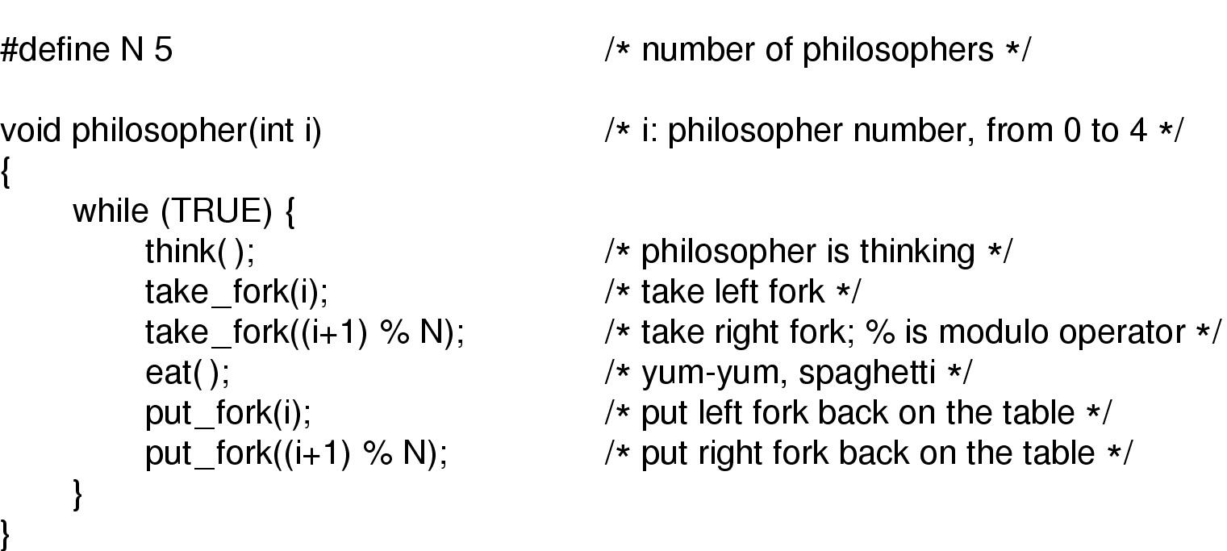
Dining Philosophers: A Solution
A nonsolution to the dining philosophers problem

Slide 69
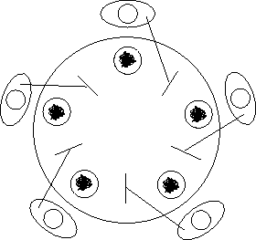
Dining Philosophers: Problems with Previous Solution
Deadlock may happen
  Everyone takes the left
  fork simultaneously

Slide 70
Dining Philosophers: Problems with Previous Solution
Tentative Solution:
After taking left fork, check whether right fork is available.
If not, then return left one, wait for some time and repeat again.
Problem:
All of them start and do the algorithm synchronously and simultaneously: STARVATION (A situation in which all the programs run forever but fail to make any progress)
Solution: Random wait; but what if the most unlikely of same random number happens?)

Slide 71
Dining Philosophers:Another Attempt, Successful!
void philosopher(int i)
{
while (true)
{
think();
down(&mutex);
take_fork(i);
take_fork((i+1)%N);
eat();
put_fork(i);
put_fork((i+1)%N);
up(&mutex);
}
}
Theoretically solution is OK- no deadlock, no starvation.
Practically with a performance bug:
  Only one philosopher can be eating at any instant: absence of parallelism

Slide 72
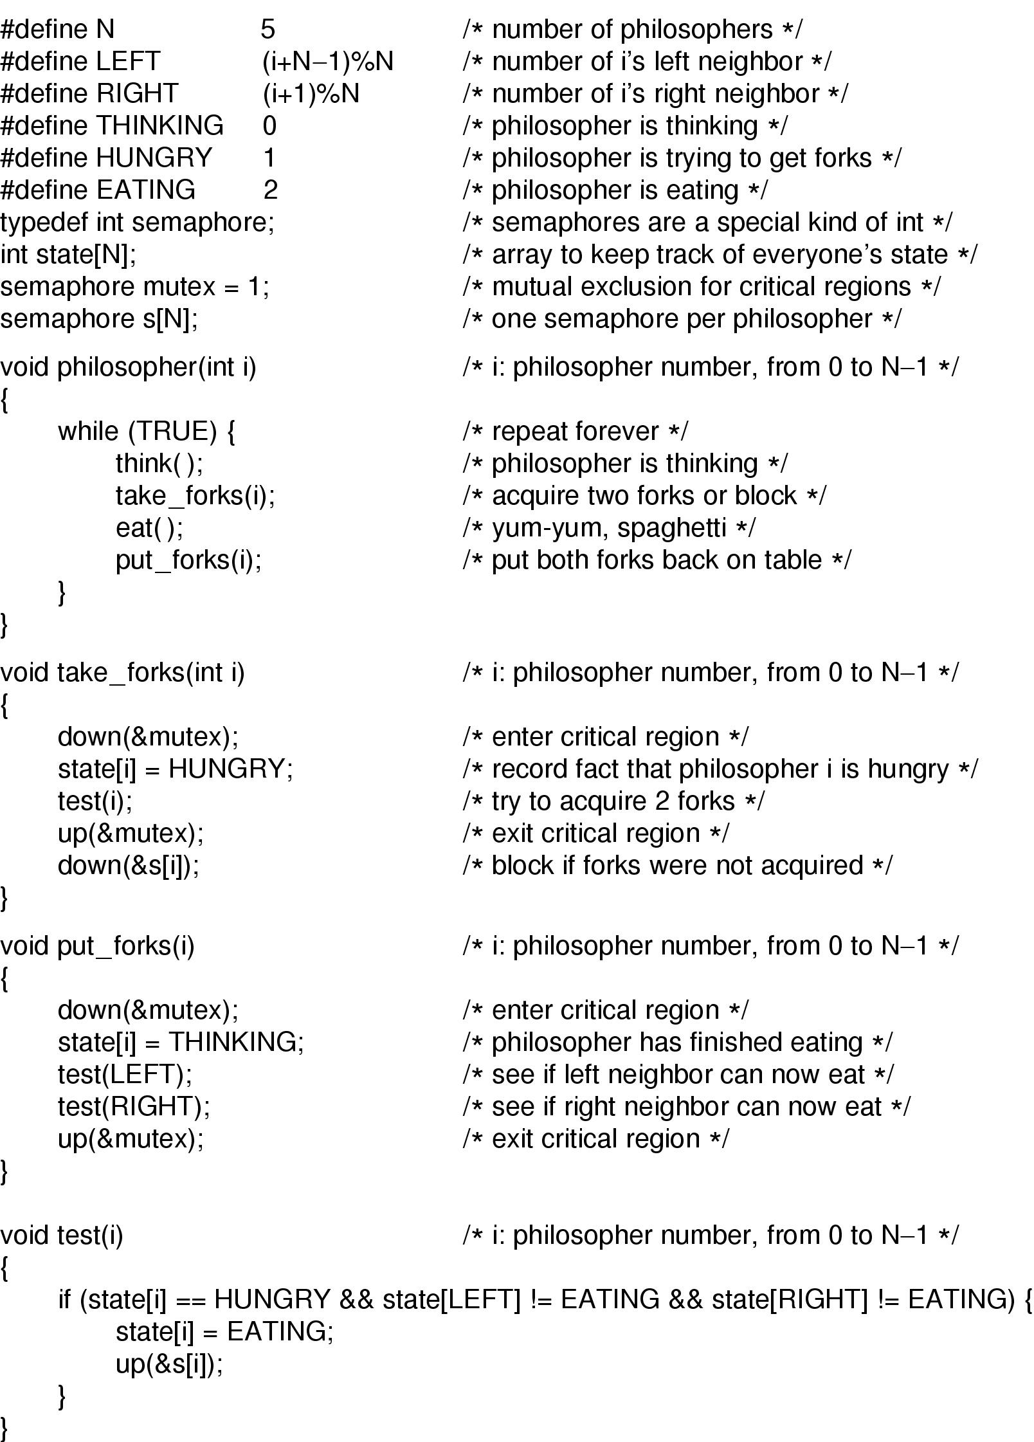
Dining Philosophers: Solution (Part 1)
Solution to dining philosophers problem (part 1)

Slide 73
semaphore Forks[N] = {1,1,1,1,1} ;
void take_fork(int i)
{
down(Forks[i]) ;
}
void put_fork(int i)
{
up(Forks[i]) ;
}
Problems?

Slide 74
Dining Philosophers: Solution Part 2
Solution to dining philosophers problem (part 2)

Slide 75
The Readers and Writers Problem(1)
Dining Philosopher Problem: Models processes that are competing for exclusive access to a limited resource
Readers Writers Problem: Models access to a database
Example: An airline reservation system- many competing process wishing to read and write-
  Multiple readers simultaneously- acceptable
  Multiple writers simultaneously- not acceptable
  Reading, while write is writing- not acceptable

Slide 76
First variation – no reader kept waiting unless writer has permission to use shared object
Second variation – once writer is ready, it performs write asap

Slide 77
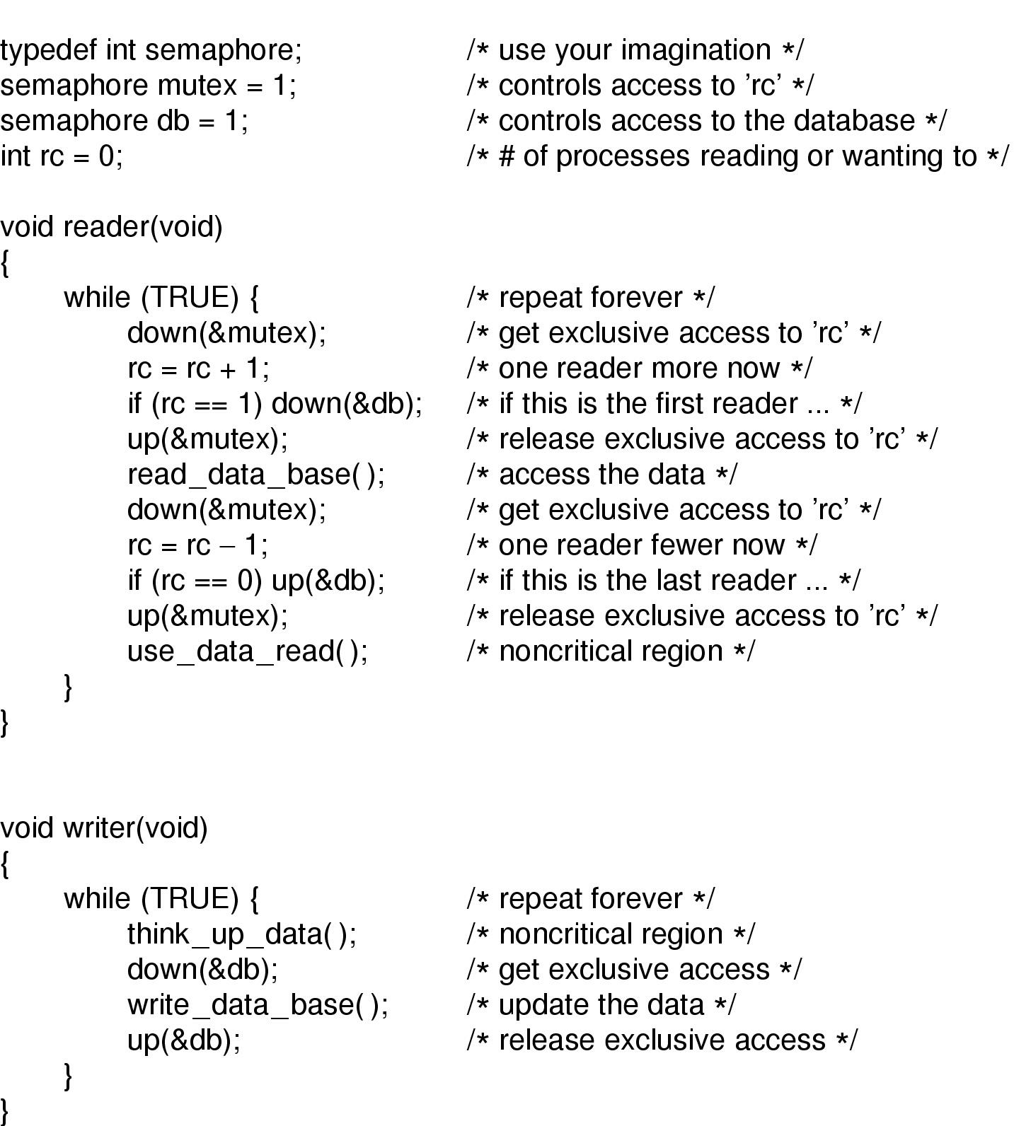
A solution to the readers and writers problem

Slide 78
The Readers and Writers Problem(3)
Issue regarding the solution
Inherent priority to the readers
Say a new reader arrives every 2 seconds and each reader takes 5 seconds to do its work. What will happen to a writer?
Issue regarding second variation
Writer don’t have to wait for readers that came along after it
Less concurrency, lower performance

Slide 79
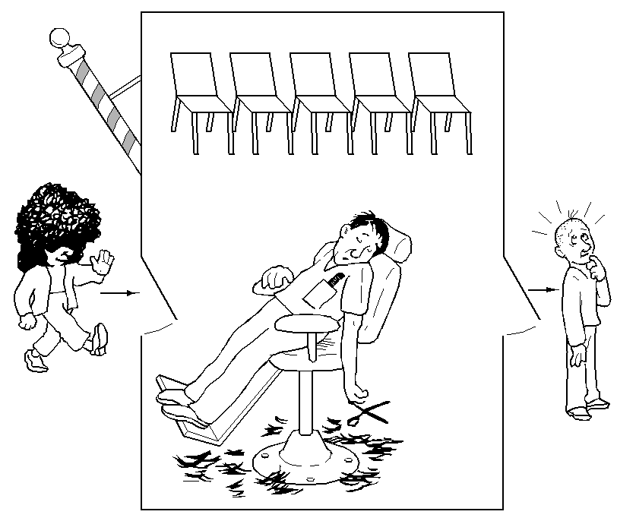
The Sleeping Barber Problem (1)

Slide 80
The Sleeping Barber Problem
One barber, n chairs for waiting customers
No customer => barber sleeps
Customer has to wake a sleeping barber
Additional customers will either wait or leave
Models a queuing situations

Slide 81
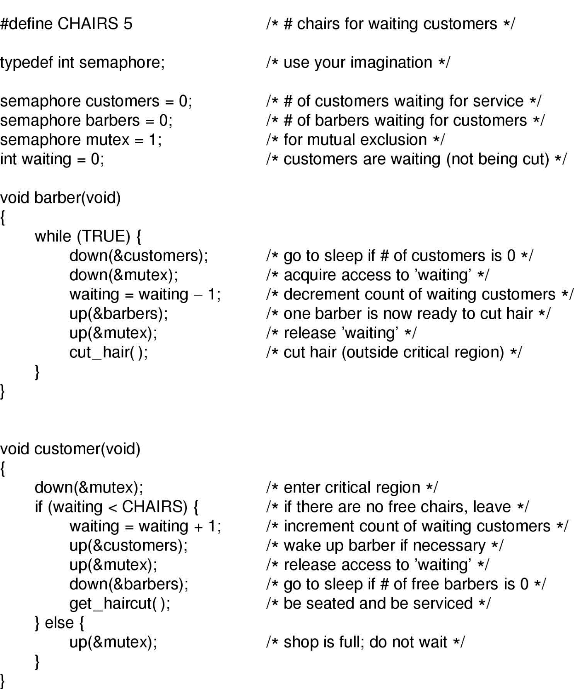
?

Slide 82
Scheduling
When more than one process is ready to run, but only one CPU is available, a choice is to make
Part of OS that does it is scheduler
The algorithm it uses is scheduling algorihm

Slide 83
Scheduling
Efficiency is needed as process switching is costly:
  Switch from user mode to kernel mode
  State of current process need to be saved
  Memory map may be saved
  A process is selected
  MMU to be reloaded with memory map of new process
  New process is started

Slide 84
Importance of Scheduling
Good scheduling algorithms can make a big difference
  Resource utilization
  Perceived performance & User satisfaction
  Meeting other system goals (e.g., important tasks being taken care of immediately)

Slide 85
Process Behavior
Processes usually alternate bursts of computing with I/O requests.
CPU burst: the amount of time the process uses the processor before it is no longer ready
I/O in this sense is when a process enters the blocked state waiting for an external device to complete its work

Slide 86
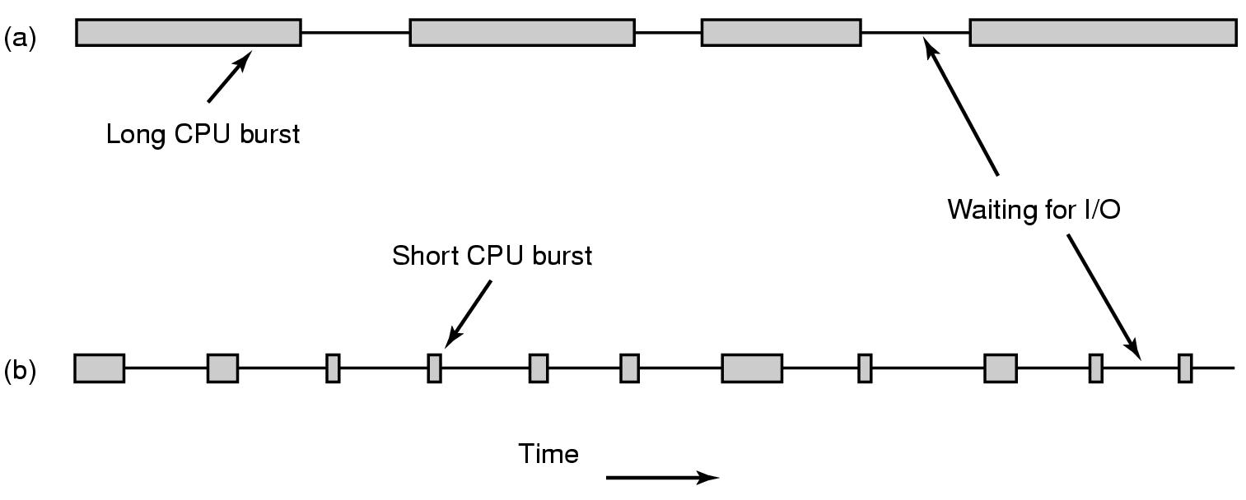
Process: Compute- and I/O-bound
  a CPU-bound process (data encryption/decryption, multimedia encoding)
  Spend most of the time computing
  Long CPU bursts => infrequent I/O waits
an I/O bound process (shell waiting for user commands)
  Spend most of the time waiting for I/O
  Short CPU bursts => frequent I/O waits
Key factor is the length of CPU burst not the length of the I/O burst

Slide 87
Process: Compute- and I/O-bound
As the CPUs get faster, processes tend to get more I/O bound: WHY?
If a I/O bound process is ready, it should get a chance quickly.
  Increase resource utlization

Slide 88
When to Schedule: Issues(1)
When a new process is created: which one to run? Parent or child? Both are Ready.
When a process exits: One of the ready processes should be run
  If none is ready a system-supplied idle process is normally run
When a process blocks: Another process has to be selected to run
  Sometimes the reason for blocking may play a role in the choice (A is waiting for B and B is in CR)
  Blocking may occur for:
    I/O
    Semaphore

Slide 89
When to Schedule: Issues(2)
When an I/O interrupt occurs: a scheduling decision may be made. In case of an interrupt of an I/O device having completed its work, some blocked process may now be ready.
If a clock provides periodic interrupt: A scheduling decision can be made at each (or k-th) clock interrupt.

Slide 90
Preemptive & Non-preemptive
Classification of Scheduling Algorithm depending on dealing with clock interrupt
Non-preemptive: Picks a process to run and lets it run until it blocks or voluntarily releases the CPU. In effect at each clock interrupt, no scheduling is done.
Preemptive: Picks a process and lets it run for a maximum of some fixed time. If still running, it is suspended and another is picked.
Preemptive scheduling requires having a clock interrupt occur at the end of the time interval to give control of the CPU back to the scheduler.

Slide 91
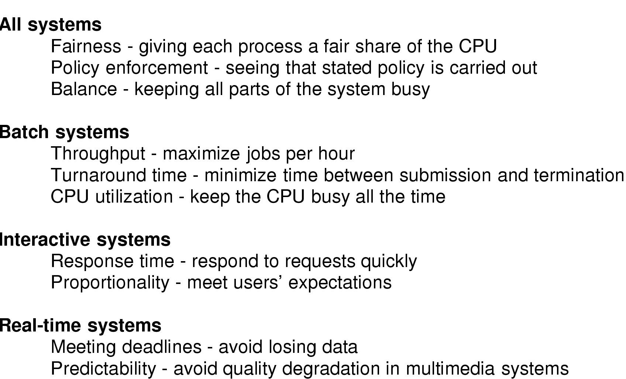
Different Systems, Different Focuses

Slide 92
Batch Systems
Users submit their job to the batch system
Batch system starts user job when appropriate
User gets notification that job is done. No interaction in between
No users impatiently waiting at terminals for a quick response to a short request
Used in business world such as Profit calculation at banks, claims processing at insurance companies…

Slide 93
Batch Systems
Common performance metrics
  Throughput: number of jobs completed per hour
  Turnaround time: average time between the submission and completion of a job
Maximizing Throughput may not necessarily minimize Turnaround time

Slide 94
Batch Systems
Algorithms used:
non-preemptive algorithms
preemptive algorithms with long time periods are often acceptable
    Reduces process switches and improves performance
Representative algorithms:
  First Come First Serve (FCFS)
  Shortest Job First
  Shortest Remaining Time First.

Slide 95
First Come First Serve (FCFS)
Process that requests the CPU FIRST is allocated the CPU FIRST.
Also called FIFO
non-preemptive
Used in Batch Systems
Real life analogy?
  Fast food restaurant
Implementation
  FIFO queues
  A new process enters the tail of the queue
  The schedule selects from the head of the queue.

Slide 96
FCFS Example
Process | Duration[Burst Time] | Order | Arrival Time
P1 | 24 | 1 | 0
P2 | 3 | 2 | 0
P3 | 4 | 3 | 0
The final schedule:
P1 (24)
P2 (3)
P3 (4)
0
24
27
P1 turnaround: 24
P2 turnaround: 27
P3 turnaround: 31
The average turnaround:
(24+27+31)/3 = 27.33
#avg waiting time:
(0+24+27)/3 = 17

Slide 97
FCFS Example 2
Process | Duration | Order | Arrival Time
P1 | 24 | 1 | 0
P2 | 3 | 2 | 2
P3 | 4 | 3 | 4
The final schedule:
P1 (24)
P2 (3)
P3 (4)
0
24
27
P1 turnaround: 24
P2 turnaround: (27-2) = 25
P3 turnaround: (31-4) =27
The average turnaround:
(24+25+27)/3 = 25.33
#avg waiting time:
(0+(24-2)+(27-4))/3 = 15

Slide 98
Advantage
Easy to understand and implement
Fair

Slide 99
Problems with FCFS
Non-preemptive
Non optimal turnaround
Cannot utilize resources in parallel:
  Assume 1 process CPU bounded and many I/O bounded processes
  result: Convoy effect, low CPU and I/O Device utilization
  Why?

Slide 100
Convoy effect
When the CBP uses the CPU, The IBPs are waiting behind it, leaving the I/O devices idle.
When the CBP finally relinquishes the CPU, then the I/O processes pass through the CPU quickly, leaving the CPU idle while everyone queues up for I/O,
then the cycle repeats itself when the CBP gets back to the ready queue.

Slide 101
Shortest Job First (SJF)
Scheduling algorithm in batch systems
Schedule the job with the shortest run time first
Requirement: the run time needs to be known in advance
SJF is optimal in terms of turnaround, if all jobs arrive at same time

Slide 102
SJF: Example
Process | Duration | Order | Arrival Time
P1 | 6 | 1 | 0
P2 | 8 | 2 | 0
P3 | 7 | 3 | 0
P4 | 3 | 4 | 0
P4 (3)
P1 (6)
P3 (7)
P2 (8)
3
9
16
24
0
Do it yourself
P4 turnaround: 3
P1 turnaround: 9
P3 turnaround: 16
P2 turnaround: 24
Total execution time: 24
The average turnaround:
(3+9+16+24)/4 = 13

Slide 103
Comparing to FCFS
Process | Duration | Order | Arrival Time
P1 | 6 | 1 | 0
P2 | 8 | 2 | 0
P3 | 7 | 3 | 0
P4 | 3 | 4 | 0
P1 (6)
P2 (8)
P3 (7)
P4 (3)
0
6
14
21
24
The total time is the same.
The average turnaround:
(6+14+21+24)/4 = 16.25
(comparing to 13)
P1 turnaround: 6
P2 turnaround: 14
P3 turnaround: 21
P4 turnaround: 24

Slide 104
SJF is not always optimal
SJF optimal only if all jobs have arrived at scheduling time
Process | Duration | Order | Arrival Time
P1 | 10 | 1 | 0
P2 | 2 | 2 | 2
P1 (10)
P2 (2)
0
2 (p2 arrives)
10
12
The average turnaround (AWT):
(10+10)/2 = 10
P1 turnaround: 10
P2 turnaround: 10

Slide 105
Preemptive SJF
Also called Shortest Remaining Time Next
  Schedule the job with the shortest remaining time required to complete
  When new job arrives, compare its total time with the remaining time of the running job
  If the new job needs less time the current job is suspended and the new job started
Requirement: the run time needs to be known in advance

Slide 106
Preemptive SJF: Same Example
Process | Duration | Order | Arrival Time
P1 | 10 | 1 | 0
P2 | 2 | 2 | 2
P1 (2)
P2 (2)
P1 (8)
0
2
4
12
P1 turnaround: 12
P2 turnaround: 0
The average turnaround:
(0+12)/2 = 6

Slide 107
Problem with Preemptive SJF?
Starvation
  In some condition, a job is waiting for ever
  Example: Preemptive SJF
    Process A with run time of 1 hour arrives at time 0
    But every 1 minute, a short process with run time of 1 minute arrives
    Result of Preemptive SJF: A never gets to run
What’s the difference between starvation and a dead lock?

Slide 108
Interactive System
Example: Servers
  Serve multiple remote users all of whom are in a big hurry
Performance Criteria
  Min response time: respond to requests quickly
  Best proportionality: meet users’ expectation
Representative algorithms:
  Round-robin
  Priority-based
  Shortest process time
  Guaranteed Scheduling
  Lottery Scheduling
  Fair Sharing Scheduling

Slide 109
Interactive System
Algorithms used here usually preemptive
  Time is sliced into quantum (time intervals)
  Scheduling decision is also made at the beginning of each quantum
Representative algorithms:
  Round-robin
  Priority-based
  Shortest process time
  Guaranteed Scheduling
  Lottery Scheduling
  Fair Sharing Scheduling

Slide 110
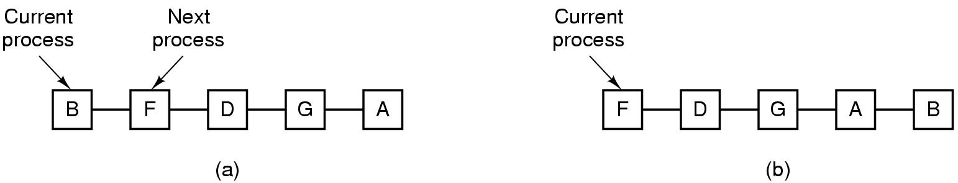
Round Robin
Round Robin (RR)
  Often used for timesharing
  Ready queue is treated as a circular queue
  Each process is given a time slice called a quantum
  It is run for the quantum or until it blocks
  RR allocates the CPU uniformly (fairly) across participants from ready queue.
Problem:
  Do not consider priority
  Context switch overhead

Slide 111
RR with Time Quantum = 20
Process Run Time Arrival Time
P₁ 53 0
P₂ 17 0
P₃ 68 0
P₄ 24 0
SJF== 0---p2(17)---17---p4(24)------41---p1(53)---94—p3(68)----162
The Gantt chart is
Higher average turnaround: (134+37+162+121)/4=113.5
If SJF = 17+41+94+162 / 4 =77.75
But better response time
P₁
P₂
P₃
P₄
P₁
P₃
P₄
P₁
P₃
P₃
0
20
37
57
77
97
117
121
134
154
162

Slide 112
RR: Choice of Time Quantum
Performance depends on length of the timeslice
  Context switching isn’t a free operation.
  If timeslice time is set too high
    attempting to amortize context switch cost, you get FCFS.
      i.e. processes will finish or block before their slice is up anyway
      Poor response time
  If it’s set too low
    you’re spending all of your time context switching between threads.
  A quantum around 20-50 msec is often a resonable compromise

Slide 113
Priority Scheduling
Each job is assigned a priority.
Select highest priority job to run next.
Rational: higher priority jobs are more important
  Example: DVD movie player vs. send email
Problems:
  Low priority process may starve
Solution:
  Priority need to be adjusted depending on the situation

Slide 114
Assign Priority
Two approaches
  Static (for system with well known and regular application behaviors)
  Dynamic (otherwise)
Priority may be based on:
  Cost to user.
  Importance of user.
  Percentage of CPU time used in last X hours.

Slide 115
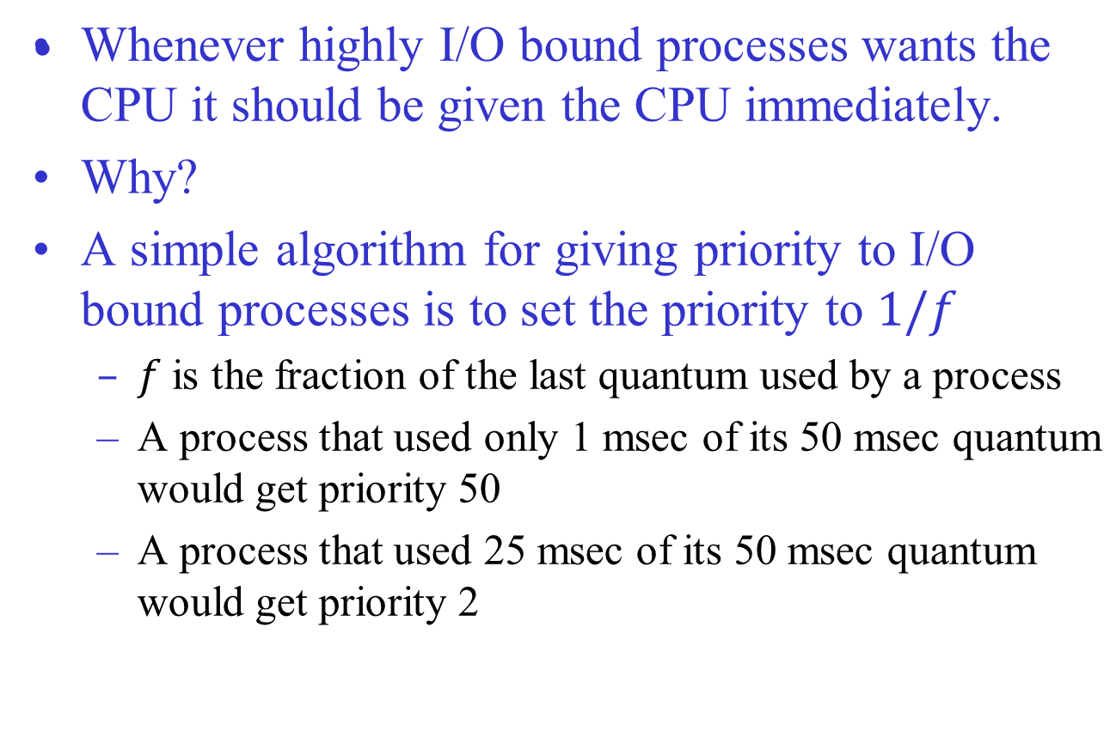
Example: Dynamic Priority Assignment

Slide 116
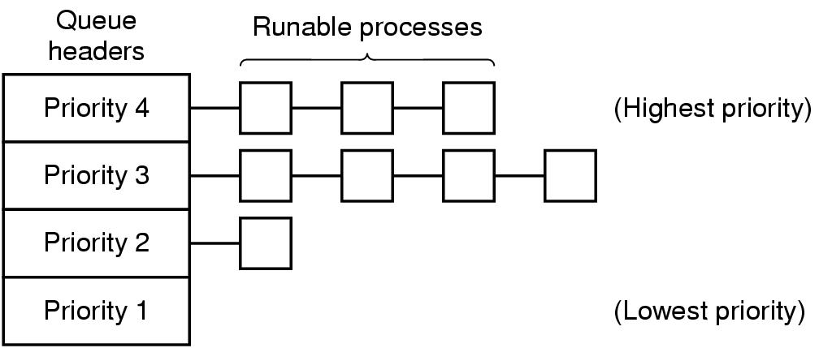
Priority class
It is often convenient to group processes into priority classes and use priority scheduling among the classes but RR within each class
If priorities are not adjusted occasionally, lower priority classes may all starve to death

Slide 117
Shortest Process Next
Let’s apply SJF for interactive processes
General pattern of a interactive process: wait for command, execute command, …
Let’s regard the execution of each command as a separate “job”
Now we can minimize overall response time by running the process with shortest “job” first.

Slide 118
Shortest Process Next
How to know which of the currently runnable processes has the the shortest job?
A possible answer: Aging
Make estimate based on past behavior and run the process with the shortest estimated time
  Let the estimated time per command for some terminal is T₀
  its next run is measured to be T₁
  We could update our estimate by aT₀+ (1-a)T₁
  For a=2, the successive estimates are

Slide 119
Guaranteed Scheduling
Make promises to users about performance & then meet those promises.
With n processes running, each one should get l/n of the CPU cycles.
Calculate ratio for each process.
Amount of CPU time process has had since its creation
Amount of CPU time process should have since creation
Run the process with the lowest ratio until its ratio has moved above its closest competitor
Problem:
  Implementation is difficult.

Slide 120
Lottery Scheduling
Give processes lottery tickets for CPU time.
Whenever a scheduling decision has to be made, a lottery ticket is chosen at random, and the process holding that ticket gets the CPU.
More important processes can be given extra tickets, to increase their chances of winning.
If there are 100 tickets and one process holds 20 of them, it will have a 20% chance of winning each lottery.
In the long run, it will get about 20% of the CPU.
Highly Responsive:
  if a new process shows up and is granted some tickets,
  at the very next lottery it will have a chance of winning in proportion to the number of tickets it holds.

Slide 121
Lottery Scheduling
Cooperating processes may exchange tickets if they wish.
  When a client process sends a message to a server process and then blocks, it may give all of its tickets to the server, to increase the chance of the server running next.
  After finishing, it returns the tickets so that the client can run again.
Can solve problems that are difficult to handle with other methods
  In a video server several processes are feeding video streams to their clients, but at different frame rates.
  Let the processes need frames at 10, 20, and 25 frames/sec.
  By allocating these processes 10, 20, and 25 tickets, respectively, they will automatically divide the CPU in approximately the correct proportion, that is, 10:20:25.

Slide 122
Fair Share Scheduling
Schedule considering the process owner.
Each user is allocated some fractions of the CPU and scheduler picks processes in such a way to enforce it.
  Consider a system with two users, each of which has been promised 50% of the CPU.
  User 1 has 4 processes, A, B, C, and D, and user 2 has only 1 process, E.
  If round-robin scheduling is used, a possible scheduling sequence:
  A E B E C E D E A E B E C E D E ...
  if user 1 is entitled to twice as much CPU time as user 2
  A B E C D E A B E C D E ...

Slide 123
Real-Time Systems
Time plays an essential role
Usually the computer must react appropriately to events generated by external devices within a fixed amount of time
  Computer in disc player
    Must convert data from the drive into sound within a very short time interval otherwise !!?!?
  Patient monitoring, autopilot, robot control…
Getting right answer but too late == Getting nothing at all

Slide 124
Real-Time Systems
2 types
  Hard real time
  Soft real time
Real time behavior is achieved by
  Divide the program into a number of predictable, short lived processes
  When an external event is detected the scheduler schedules the processes properly to met all deadlines

Slide 125
Real-Time Systems
2 types of event
  periodic
  aperiodic
A system may have to respond to multiple periodic event streams
It is not always possible to handle all events

Slide 126
Scheduling in Real-Time Systems
Given
  m periodic events
  event i occurs with period P_{i} and requires C_{i} seconds CPU time to handle
Then the load can only be handled if
A real-time system that meets this criterion is said to be Schedulable

Slide 127
Scheduling in Real-Time Systems
Scheduling algorithm can be
  Static: make Scheduling decisions before the system starts running
    Need to know about the work to be done and the deadlines to meet
  Dynamic: make Scheduling decisions at run time
BAD NEWS: Perhaps we would not learn the specific algorithms in this course!!! Please be patient.

Slide 128
Policy versus Mechanism
Separate what is allowed to be done with how it is done to make the best decision
  a process may know which of its children processes are important and need priority
  A DBMS process may have many children working on different things such as query processing, disk access etc
How?
  Scheduling algorithm is parameterized
    mechanism in the kernel
  Parameters filled in by user processes
    policy set by user process

Slide 129
User-level Thread Scheduling
Kernel picks a process and thread scheduler inside the process decides which thread to run
Fast Thread switching
Application specific thread scheduler can be used to maximize output
  The run time system knows each thread under it

Slide 130
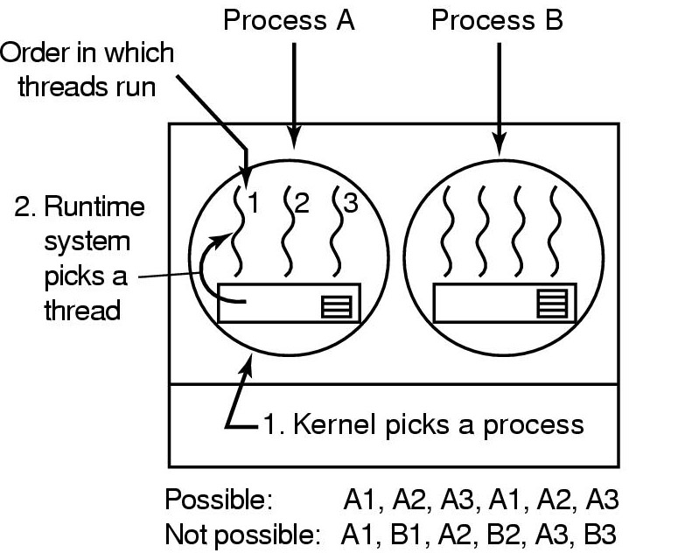
User-level Thread Scheduling
Possible scheduling of user-level threads
50-msec process quantum
threads run 5 msec/CPU burst

Slide 131
Kernel-level Thread Scheduling
Kernel picks a particular thread to run
Having a thread block on I/O does not suspend the entire process
Expensive thread switching

Slide 132
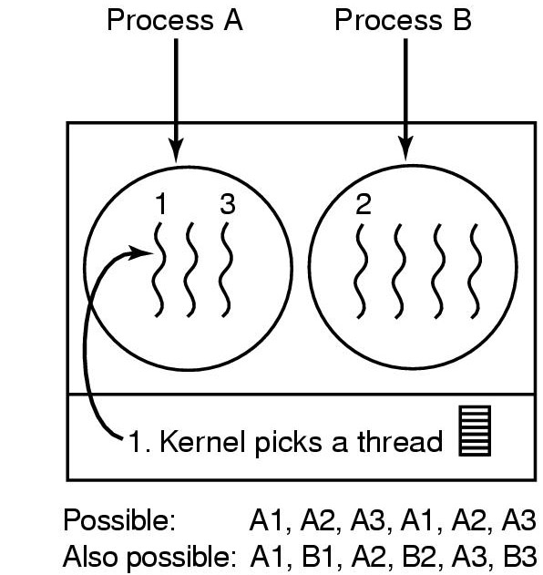
Kernel-level Thread Scheduling
Possible scheduling of kernel-level threads
50-msec process quantum
threads run 5 msec/CPU burst

